Slide 1

Biden’s Capital Gain Tax Plan
FINA1303 - Group 18

Slide 2
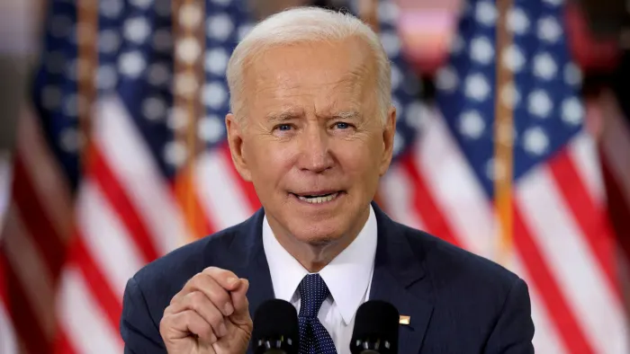
Biden Recent Capital Gain Tax Proposal Shock the Market
Raising capital gain tax for the top wealth and terminating tax break on inheritance
Biden Broader Tax Proposal
Objective
Eliminate the tax break between asset inheritance and asset, also known as the step-up in basis at death
Fund the American Families Plan, including preschool education and paid leave programs
“US President Joe Biden is reportedly set to propose a tax hike on the wealthiest Americans”
Proposal
Details
Recently, Biden announced to raise the top capital gain rate from 20% to 39.6% on those earning $1 million or more (0.3% of taxpayers)
Coupled with the existing 3.8% Medicare surtax on investment income
A higher 28% capital gain rate applies to investment in small businesses and collectibles
Expected to raise $113 billion over a decade starting in 2022
Allow exemptions for individuals with property under $1 million or couples under 2.5 million
Source: Bloomberg, The White House, CNBC, BBC

Slide 3
A Brief Explanation on Capital Gain Tax
A tax on the rise in market value of investments incurred when individuals or corporations sell those investments
Capital Gain Tax Classification
Key Facts
Capital Gain: Selling a capital asset—for example, stocks, bonds, precious metals, or real estate—for more than the purchase price
Unsold investments will not be applied to capital gain tax
The U.S. capital gains tax only applies to Long-Term capital gains
Taxable Capital Gain (net capital gain) for the year = Total Capital Gain - Total Capital Loss
Long-Term Capital Gain Tax
Short-Term Capital Gain Tax
Only applies to profits from the sale of investments held for more than a year
Tax rate can be 0%,15%,20%, depends on tax brackets
Only applies to investments held for a year or less.
Capital gain will be added to ordinary income and are subjected to ordinary income tax
Source: Capital Gains Tax, Investopedia

Slide 4




Motivations Behind Rising Tax
Increase tax to pay for investments in childcare, healthcare and boosting economic growth
1
Invest in families
2
Build Infrastructure
3
Boost economic growth
Fund the 2 trillion American Families Plan, including childcare & education
Termination of tax break on inheritances closes loopholes for top earners to evade tax
Build physical infrastructure including bridges and airports
Discourage rate arbitrage for the wealthy
Subsidise the Affordable Care Act (Obamacare)
Boost “human infrastructure” including education and a nationwide paid leave program
Cut tax for lower- and middle- income workers and families
Create a larger amount of cash flow in the market as a driver force for economic growth in the US
Source: CNBC, Wall Street Journal, NY Times

Slide 5



Overview on Impacts and Reactions of Capital Gain Tax Hike
Various impacts on different market players are expected and shall not be underestimated
Market
Ultra Wealthy Investors
Financial Institutions
Multiple markets will be affected due to demand shift and change in investment preference
Investment strategies and asset allocations are affected due to the tax hike
Impact directly on financial institutions in terms of revenue and performance
Proposed Capital Gain Tax Increase Affect Multiple Stakeholders and Bring Greater Impact than Expected

Slide 6
Possible Market Response To Tax Rise
Both long-term and short-term effect is expected in the financial markets
Stock Market
Bond Market
Money Market
Short Term reaction
Fast growing stock such as Technology, Pharmaceutical stocks would lose out
Price of short-term bond will rise due to an increase demand of Short term bond, as investment profit within 1 year is not subjected to Capital gain tax
Increase in money supply due to incentive of investment decrease
Long Term
reaction
Competitiveness of US stock will decrease, as potential gain of investment in US decreases
Less people will prefer Long term bond as it will be subjected to Capital gain tax. Hence, coupon rate may increase to attract investors
Increases in cash reserves.
Inflation rate may also increases due to the increase in Money supply
The rise in capital gain tax may cause short-term volatility and hinder long-term growth
Source: Reuters, Investopedia

Slide 7
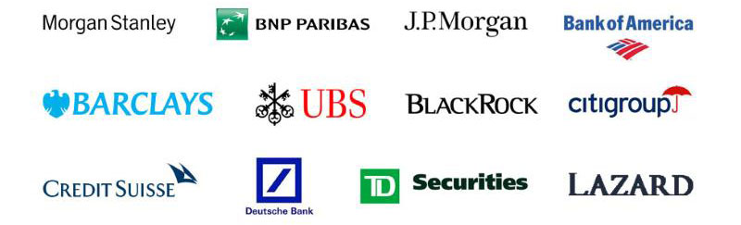

Selected Potential Effects on Financial Institutions
The capital gain tax impact substantially to both buy side and sell side
Potential Reduction in Investment Activities and Profit Caused by Increased Capital Gain Tax
Sell Side
Buy Side
Income Stream
Fund Revenue and Compensation
M&A transactions may be affected and impacting investment banks’ fee income
Capital may flow to money market such as private lending and credit which may affects the banks loan revenues
Overall impact subject to other market factors and forces
Lessen post-tax sales proceeds
The lower carried interest significantly reduced compensation of senior fund managers and investors
The possible shift from investment to consumption may harm or break the capital chains and thus financial stability
Source: Bloomberg, Houlihan Lokey

Slide 8
Potential Reactions of Ultra Wealthy Investors
Investment strategies may readjusted in response to raising the capital gain tax
Taxable
Investor
Investors that making more than $1 million a year will be subject to the higher tax rate
The ultra-wealthy taxpayers represented 0.3% of tax filers in 2018
Key Outlook and Takeaways
Some investors may choose to harvest capital gain now; some would not have immediate actions
Historical
Results
Capital gain tax rose 9% in 2013 yet the stock market rose 30% that year
No correlation between capital gain tax and stock performance found
Multiple investment strategies may adopted to hedge against the raising capital gain tax
Potential Reactions
Options between hold, turnover the portfolio, and reallocating wealth to different asset classes
Doubt on the actual impact of raising capital gain tax and even successfully passed in the Congress
Retain the control of avoid paying tax by not realizing the net capital gain
Additional short-term modest equity market volatility is expected and priced in, exact market outcome remains unclear
Source: Reuters, UBS

Slide 9
Biden Recent Capital Gain Tax Proposal Shock the Market
Raising capital gain tax for the top wealth and terminating tax break on inheritance
Intended Results
Biden Broader Tax Proposal
End Inheritance Tax Break
Double the capital gain tax
Eliminate the tax break between asset inheritance and asset also known as the step-up in basis” at death
Allow exemptions for individual with property under $1 million or couples under 2.5 million
In March 31, Biden announced to raise the top capital gain rate from 20% to 39.6% on those earning $1 million or more (0.3% of taxpayers)
Coupled with the existing 3.8% Medicare surtax on investment income
A higher 28% capital gain rate applies to investment in small businesses and collectibles
Expected to raise $113 billion over a decade starting in 2022
Fund Welfare Scheme
Fund the American Families Plan, including preschool education and paid leave programs
Balance wealth to fund in education, assist medical cares and provide family support
Source: Bloomberg, The White House, CNBC
Notes:
The President’s plan restores the top tax bracket to what it was before the 2017 law, returning the rate to 39.6 percent, applying only to those within the top one percent.
apply the taxes consistently to those making over $400,000, ensuring that all high-income Americans pay the same Medicare taxes 3.8%.
The President would also end the special real estate tax break—that allows real estate investors to defer taxation when they exchange property
400 000

Slide 10
Explain capital gain tax [Zita]
A tax on the rise in market value of investments incurred when individuals or corporations sell those investments
*Unsold investments will not be applied to capital gain tax
Only applies to profits from the sale of investments held for more than a year. Tax rate can be 0%,15%,20%, depends on tax brackets
Long-Term Capital Gain Tax
The U.S. capital gains tax only applies for Long-Term
Capital Gain Tax
Only applies to investments held for a year or less. Capital gain will be added to ordinary income and are subjected to ordinary income tax
Short-Term Capital Gain Tax
Taxable Capital Gain (net capital gain) for the year = Total Capital Gain - Total Capital Loss
Source: Capital Gains Tax, Investopedia

Slide 11
Effect of raising capital gains tax - overview Sandra
Higher Tax
Lower motivation of people
Raise capital gains tax
Not much impact to companies
Raise capital gains tax rate
Revenue remains the same
Think carefully before raising the capital gains tax rate
Source:

Slide 12
FI reaction (Joanne)
Expected reaction of Central Bank
Increase in capital gain tax
Decrease saving and investment
Drop in bank deposit and liquidity
print more money
liquidity expected to rise
and
attract more people to invest
lower the interest rate
Advised waiting to see Biden’s tax package in its final form
With a $600 billion infrastructure package, assuming the overall number in terms of the infrastructure and how to pay for it with taxes will be lower.
Reaction of the co-founder of an investment bank,
Blair Effron
There is going to be a lot of negotiation back and forth
Source: CNBC

